Slide 1
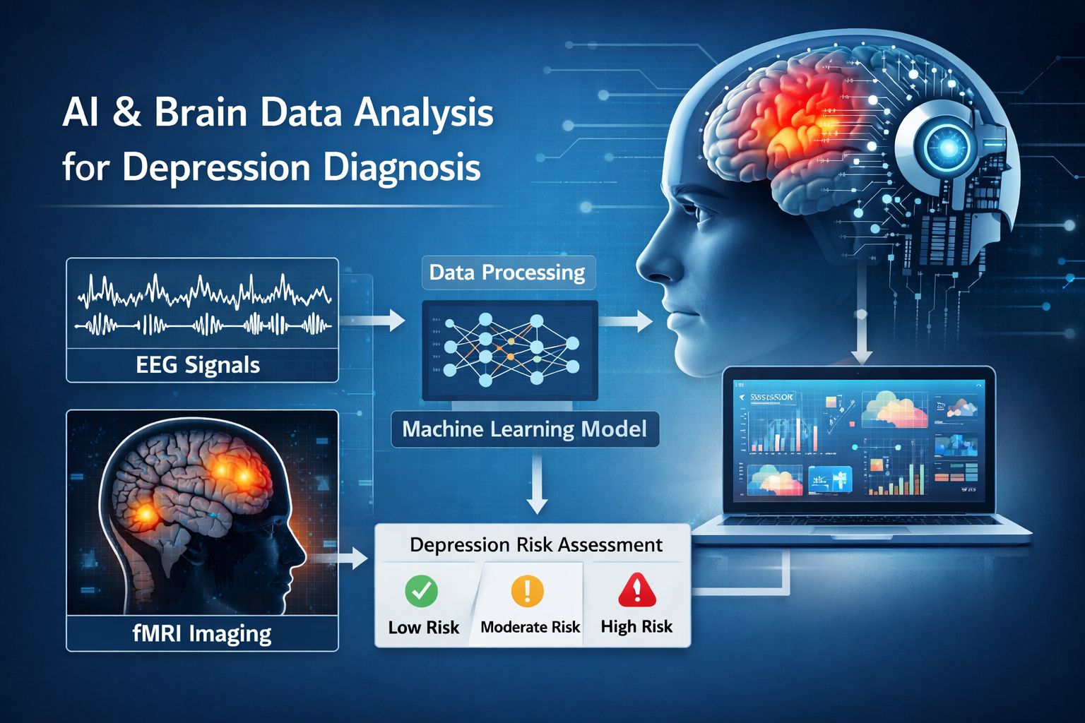
AI and Neuroimaging in Depression Prediction
Citations: (Wu et al., 2015; Sacchet et al., 2015; Ahire, 2025; Boby & Veerasingam, 2025; Liu et al., 2025; Weber et al., 2025)
By: Michael Ellis
Neuroethics Problem
Major Depressive Disorder (MDD) is commonly diagnosed using subjective symptom-based criteria, which can delay accurate diagnosis.
Artificial intelligence (AI) systems can analyze neuroimaging and behavioral data to detect patterns associated with depression.
Predictive mental health tools may enable earlier detection and intervention, but also raise concerns about privacy, bias, and stigma.
Scientific Background
Machine learning models can classify depression using MRI brain structure data (Wu et al., 2015).
Brain network connectivity analysis using diffusion-weighted imaging has identified abnormal neural connectivity in MDD (Sacchet et al., 2015).
EEG-based machine learning models detect neural biomarkers associated with emotional regulation and cognitive processing (Ahire, 2025; Boby & Veerasingam, 2025).
Multimodal models combining speech, behavioral signals, and clinical data improve diagnostic accuracy (Liu et al., 2025; Weber et al., 2025).

Slide 2
Stakeholders and Ethical Risks
Citations: (Kohrt et al., 2025; Ricci et al., 2025; Eder & Dong, 2026)
Key Stakeholders
Patients and adolescents – potential early detection but risk of stigma and labeling.
Clinicians and general practitioners – may rely on AI tools for diagnostic support.
AI developers and researchers – responsible for model design and validation.
Healthcare systems and policymakers – regulate implementation and data governance.
Insurance companies and employers – potential misuse of predictive health data.
Key Ethical Issue: Predictive Labeling and Stigma
AI tools may classify individuals as “high risk” for depression before symptoms appear.
Adolescents may experience identity harm or social stigma if labeled prematurely.
Predictive data could potentially influence education, employment, or insurance opportunities.
Ethical concerns relate to privacy, fairness, and patient autonomy.

Slide 3
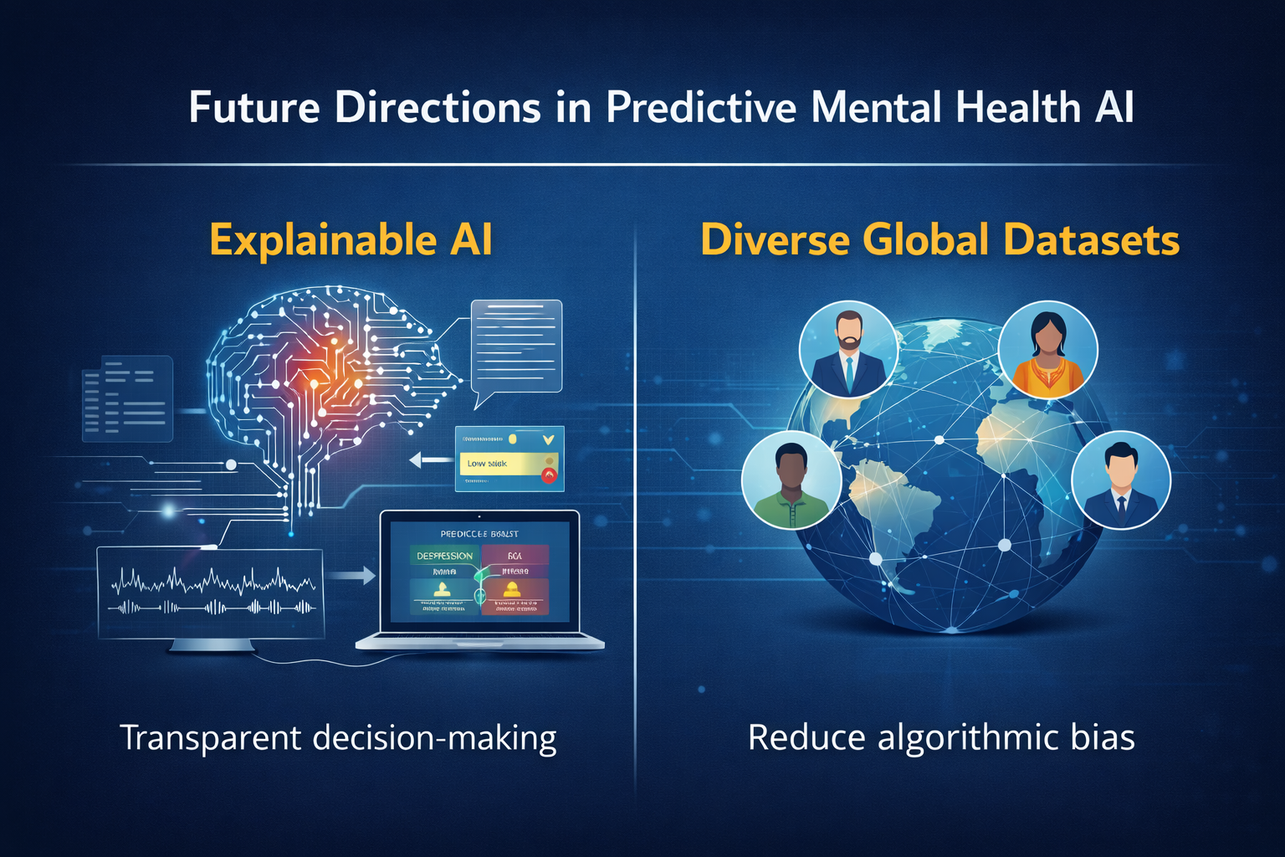
Future Directions and Implications
Citations: (Lee et al., 2020; Kohrt et al., 2025; Ricci et al., 2025; Weber et al., 2025)
Future Direction 1 — Explainable AI
Develop interpretable machine learning systems that clinicians can understand.
Improve transparency in how predictions are generated.
Increase trust and responsible use in clinical decision-making.
Future Direction 2 — Diverse and Global Datasets
Current datasets are often small and geographically limited.
Larger and more diverse datasets are needed to reduce algorithmic bias and improve reliability.
Broader Implications
Longitudinal studies to evaluate long-term outcomes of AI-assisted diagnosis.
Integration of AI tools as clinical support systems rather than replacements for clinicians.

Slide 4
References
Ahire, N. (2025). Eeg-derived brainwave patterns for depression diagnosis via hybrid machine learning and deep learning frameworks. Applied Neuropsychology: Adult, pages 1–10. PMID: 39879638. https://doi.org/10.1080/23279095.2025.2457999
Boby, K. and Veerasingam, S. (2025). Depression diagnosis: Eeg-based cognitive biomarkers and machine learning. Behavioural Brain Research, 478:115325. https://doi.org/10.1016/j.bbr.2024.115325
Eder, J. and Dong, M. S. (2026). A multimodal approach to depression diagnosis: insights from machine learning. European Archives of Psychiatry and Clinical Neuroscience, 276(2):407–420. https://doi.org/10.1007/s00406-025-01990-5
Kohrt, B. A., Wahid, S. S., Ottman, K., Burgess, A., Viduani, A., Martini, T., Benetti, S., Momodu, O., Bohara, J., Neupane, V., Gautam, K., Adewuya, A., Mondelli, V., Kieling, C., and Fisher,
H. L. (2025). No prediction without prevention: A global qualitative study of attitudes toward using a prediction tool for risk of developing depression during adolescence. Global Mental Health (Cambridge, England), 11:e129. https://doi.org/10.1017/gmh.2024.136
Lee, Y., Ragguett, R.-M., Mansur, R. B., Boutilier, J. J., Rosenblat, J. D., Trevizol, A., Brietzke, E., Lin, K., Pan, Z., Subramaniapillai, M., Chan, T. C., Fus, D., Park, C., Musial, N., Zucker-man, H., Chin-Hung Chen, V., Ho, R., Rong, C., and McIntyre, R. S. (2020). Corrigendum to “applications of machine learning algorithms to predict therapeutic outcomes in depression: A meta-analysis and systematic review”. Journal of Affective Disorders, 274:1211–1215. https://doi.org/10.1016/j.jad.2020.02.037
Liu, L., Chen, S., Chen, K., Xu, J., and Chen, X. (2025). Catching the blackdog easily: A conve-nient depression diagnosis method based on audio-visual deep learning. IEEE Transactions on Affective Computing, 16(4):3095–3109. https://doi.org/10.1109/TAFFC.2025.3571697
Ricci, F., Giallanella, D., Gaggiano, C., Torales, J., Castaldelli-Maia, J. M., Liebrenz, M., Bener, A., and Ventriglio, A. (2025). Artificial intelligence in the detection and treatment of depressive
disorders: a narrative review of literature. International Review of Psychiatry, 37(1):39–51. PMID: 40035375. https://doi.org/10.1080/09540261.2024.2384727
Sacchet, M. D., Prasad, G., Foland-Ross, L. C., Thompson, P. M., and Gotlib, I. H. (2015). Support vector machine classification of major depressive disorder using diffusion-weighted neuroimag-ing and graph theory. Frontiers in Psychiatry, 6. https://doi.org/10.3389/fpsyt.2015.00021
Weber, J., Weber, M., and Lopez Alcaraz, J. M. (2025). Depression diagnosis from patient inter-views using multimodal machine learning. Frontiers in Psychiatry, 16. https://doi.org/10.3389/fpsyt.2025.1694762
Wu, M.-J., Wu, H. E., Mwangi, B., Sanches, M., Selvaraj, S., Zunta-Soares, G. B., and Soares,
J. C. (2015). Prediction of pediatric unipolar depression using multiple neuromorphometric measurements: A pattern classification approach. Journal of Psychiatric Research, 62:84–91. https://doi.org/10.1016/j.jpsychires.2015.01.015

